Slide 1

You Only Look Once: Architectural discussion
Author
Comănac Dragoș-Mihail

Slide 2
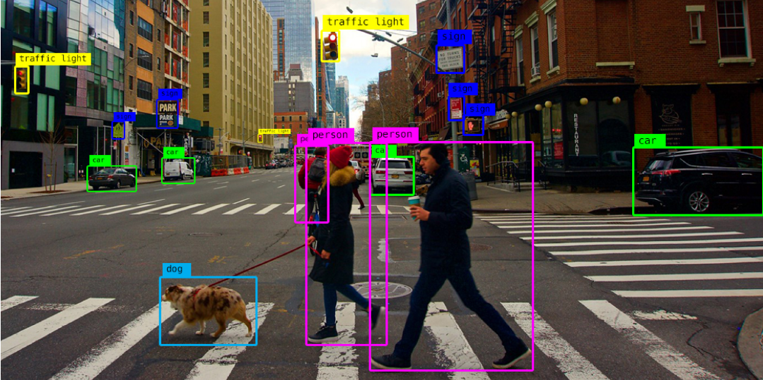
Why?
Source: https://alwaysai.co/blog/object-detection-for-businesses

Slide 3
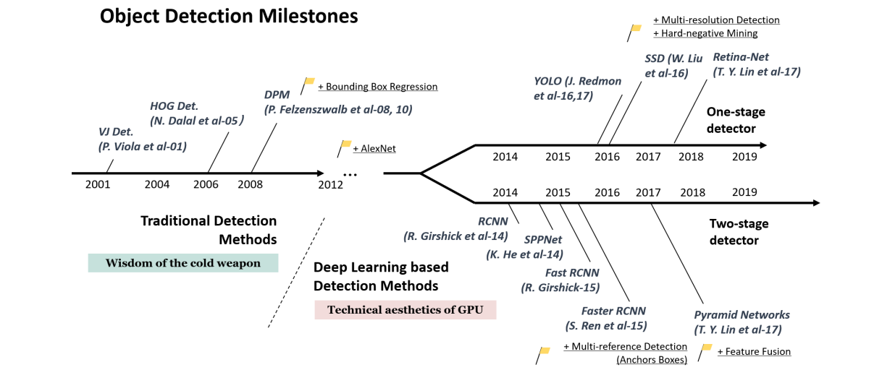
Placement in the broader field
Source: Zou, Z., Shi, Z., Guo, Y., Ye, J., 2019. Object Detection in 20 Years: A Survey. ArXiv abs/1905.05055

Slide 4

You Only Look Once (YOLO) method

Slide 5
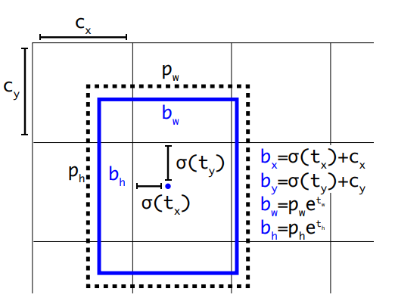
You Only Look Once (YOLO) method
Source: Joseph Redmon and Ali Farhadi. YOLO9000: Better, Faster, Stronger. 2017 IEEE Conference on Computer Vision and Pattern Recognition (CVPR), pages 6517–6525, 2017

Slide 6
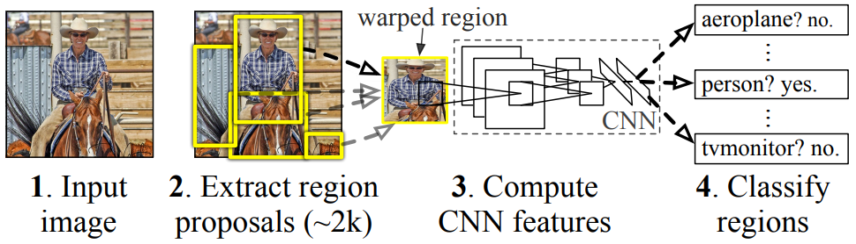
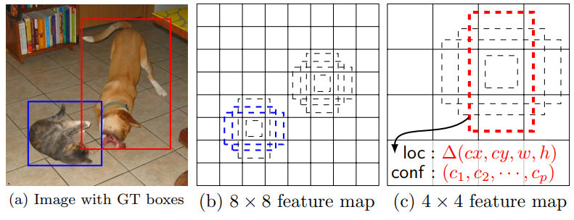
Related work
Region based
convolutional neural networks
R-CNN
Single Shot MultiBox Detector
SSD
Source: Girshick, R., Donahue, J., Darrell, T., Malik, J., 2014. Rich feature hierarchies for accurate object detection and semantic segmentation, in: Proceedings of the IEEE conference on computer vision and pattern recognition, pp. 580–587 ; Liu, W., Anguelov, D., Erhan, D., Szegedy, C., Reed, S., Fu, C.Y., Berg, A.C., 2016. SSD: Single Shot MultiBox Detector, in: European conference on computer vision, Springer. pp. 21–37

Slide 7
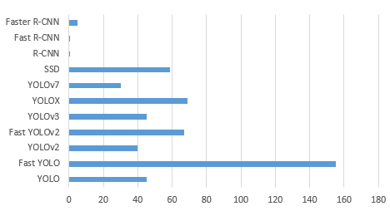
Comparison: Frames per second (FPS)
Source: Joseph Redmon and Ali Farhadi. YOLO9000: Better, Faster, Stronger. 2017 IEEE Conference on Computer Vision and Pattern Recognition (CVPR), pages 6517–6525, 2017

Slide 8
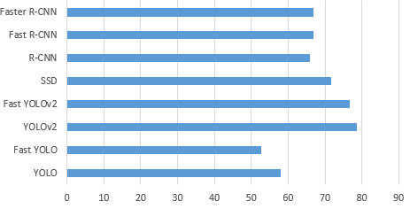
Comparison: Mean average precision (mAP) The Pascal Visual Object Classes (PASCAL VOC)
Source: Joseph Redmon and Ali Farhadi. YOLO9000: Better, Faster, Stronger. 2017 IEEE Conference on Computer Vision and Pattern Recognition (CVPR), pages 6517–6525, 2017

Slide 9
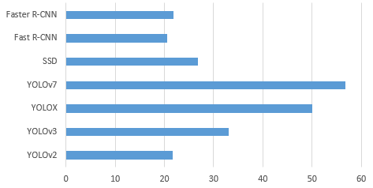
Comparison: Mean average precision (mAP) Microsoft Common Objects in Context (COCO)
Source: Joseph Redmon and Ali Farhadi. YOLO9000: Better, Faster, Stronger. 2017 IEEE Conference on Computer Vision and Pattern Recognition (CVPR), pages 6517–6525, 2017

Slide 10
Conclusions
Robust to change
Fast and accurate
Several iterations: YOLO, YOLOv2 to YOLOv7, YOLOF, YOLOX

Slide 11
Thank you!

